Slide 1
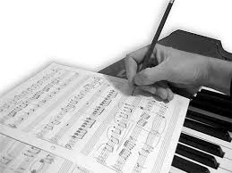
Composition

Slide 2
What you need to know!
Your composition is sent away to SQA and is worth
30 marks (15% of overall mark)
Your composed piece of music is worth 20 marks
Your evaluation of your composition process is worth
10 marks

Slide 3
What you need to do!
Compose one finished piece of music must last minimum 1min and max 3mins 30 sec
You must use four elements from melody, rhythm, structure and timbre. HARMONY has to be included!
Evaluate the process of your composition

Slide 4
Where do you start?
You can chose one the following options to start with
Create a melody on an instrument of your choice
Choose a chord pattern that you like
Start with a riff
Lyrics
Inspiration from a picture

Slide 5
Choose an instrument that you are confident on. E.g Compose melody for Keyboard or Glock
If creating a melody pick a couple of notes you like the sound of and take it from there
Remember if you don’t like something try just changing one or two notes or change the rhythm this makes a huge difference to the sound
Use question and answer technique – Question/Answer then ask the same question but reply with a different answer!

Slide 6
Applications to use
Music nOTATION
MIDI/MULTI-TRACK
Sibelius
Musescore
Soundtrap
Garageband
Bandlab
Protools

Slide 7
Review!
Worth 10 marks
Should include all the decisions you have made. E.g What chords you used & why?, Why did you pick the instrument(s) that you did…
Explain how you have explored and developed your ideas E.g I changed the rhythm…
Strengths and /or areas which could be improved.
You have to use the form on the next page. This can be typed or handwritten but must not go over the A4 page.
Try and keep a record of what you have done as you make a decision

Slide 8
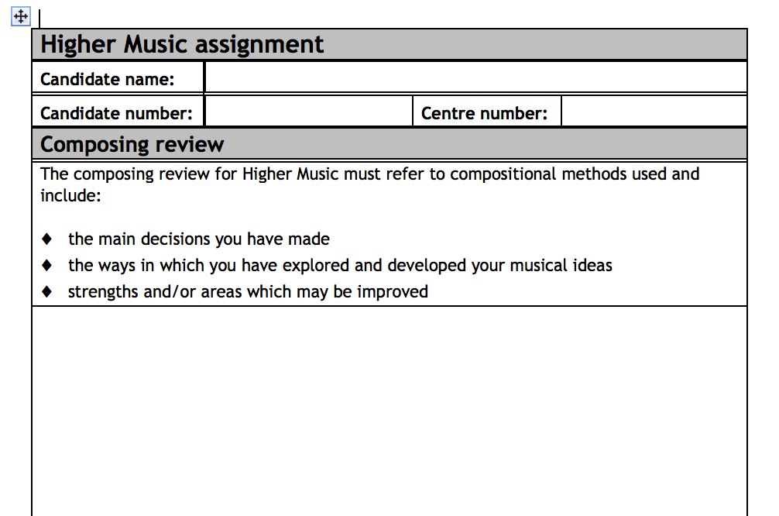
Review Form!

