Slide 1
S1 ICT Course
Animation Unit – Lesson 1

Slide 2
What is Animation?
Animation is the rapid display of a sequence of pictures which gives the illusion of movement.
Each picture is called a FRAME
The animation is normally played at a rate of 16 to 25 frames per second.

Slide 3
What is Animation?
This bouncing ball animation is made up of these 6 images (frames) which are repeated again and again.

Slide 4
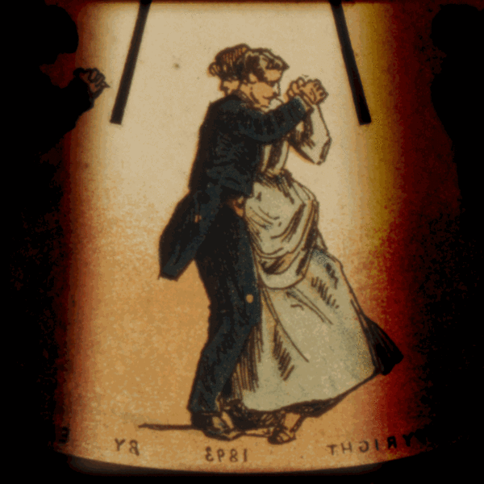
The History of Animation
Phenakistoscope
This was invented in 1832 and uses a spinning disk attached vertically to a handle.

Slide 5
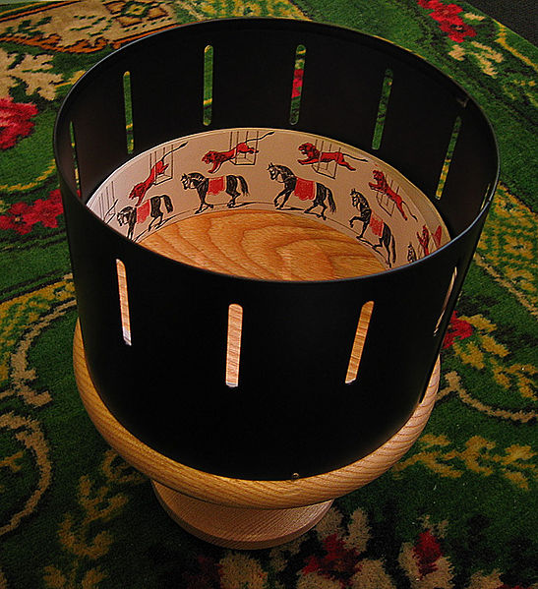
The History of Animation
zoetrope
This was invented in 1834 and uses a rotating drum with slits in it to view the images as they spin around.

Slide 6
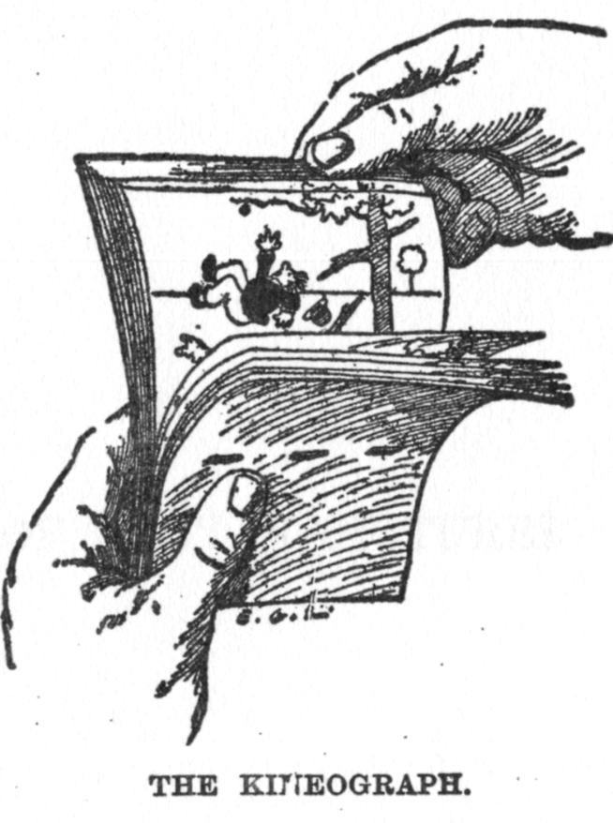
The History of Animation
Kineograph / flipbook
The Kineograph (most commonly know by the term Flipbook now) was created in 1886.
Here is a video clip of a flipbook in action:
Circus Flipbook

Slide 7
Pupil Activity
Can you create your own flipbook?
Make up an animation sequence of your own
Start from the back of the book and work your way forward
That way you can trace part of the image from page to page, making small adjustments each time
What ideas can you think of?

