Slide 1
Product Life Cycle
Business Management

Slide 2
Learning Intentions
Be aware of what the product life cycle shows
Identify the four stages of the product life cycle
Be able to describe each stage

Slide 3
Product Life Cycle
Once a product has been developed and launched into a market, it has a life cycle.
The Product Life Cycle shows us the different stages that products will go through in the market.
There are four key stages:
Introduction
Growth
Maturity
Decline

Slide 4
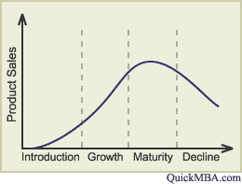
Product Life Cycle

Slide 5
Stages of the “PLC”
Introduction: Product is introduced onto the market and there will be lots of advertising/promotion to raise awareness and encourage sales.
Growth: Sales begin growing after successful advertising and promoting, more customers know about and want the product.
Maturity: Sales are at their highest level = most profitable stage.
Decline: Sales begin to fall, usually because newer, more up-to-date products come into the market and the demand has fallen

Slide 6
Remember!
Some products will have a long life cycle compared to others:
Mars Bar vs Mobile Phones
Mars bars have a steady demand and therefore have a longer life cycle than a mobile phone which will go out of date relatively quickly.

Slide 7
Life Cycle
When a new product is introduced into the market, grows over time and then declines, the product has gone through its life cycle. Some products will be re-developed and re-introduced to the market and sold again. However with changes in technology some products do decline and die out.
Design and Technology – Resistant Materials App by J Plimmer

Slide 8
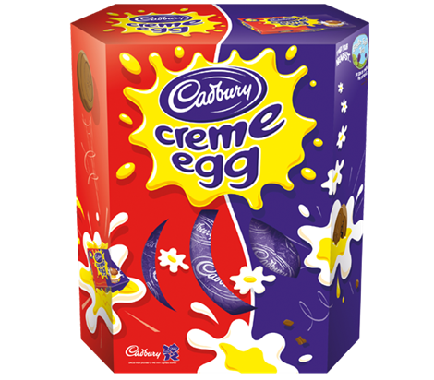
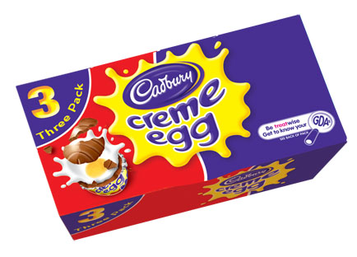
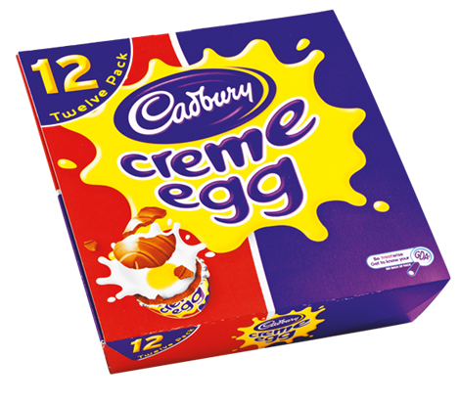
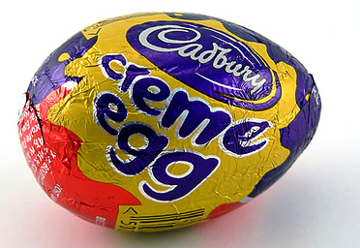
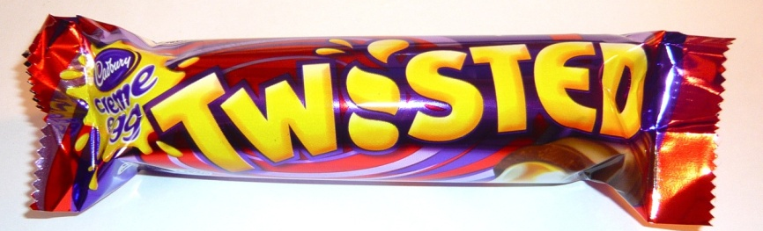
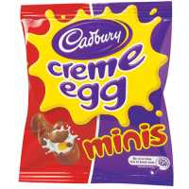
Egg-stension Strategies

Slide 9
