Slide 1
How to prepare and deliver a talk
A guide for pupils and parents

Slide 2
Delivering a talk is a major part of English courses .
Talking is an important skill in the world of work.
Yet talks in classrooms may sometimes cause anxiety for young people.
These materials are designed to ease that anxiety, and lead to a successful talk.

Slide 3
These notes cover:
First steps
Note taking
The practice talk
Final preparations

Slide 4
First steps

Slide 5
Find as much as you can about the talk
What do you have to talk about?
Is there a choice of topic, or does everyone in the class have to speak about the same thing?
What is the purpose of the talk?
Purpose is a vital part of the preparation . A talk can have many different purposes so it is vital you know the purpose of your talk.

Slide 6
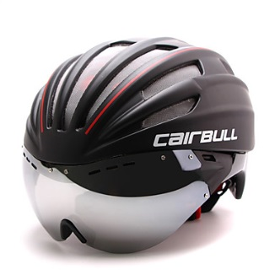
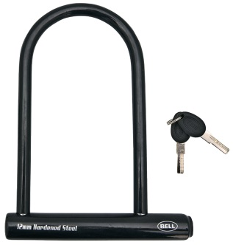
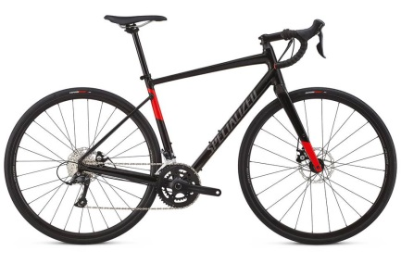
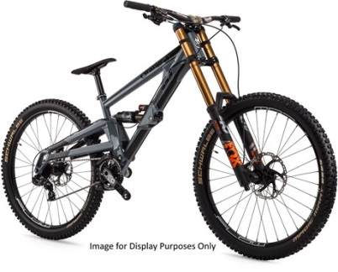
The purpose of a talk on a hobby could be to inform the audience about the hobby.
Take the example of cycling . A talk informing the class about this hobby would give information on
Equipment you need - the type of bikes available, the clothes you need, the footwear….)
The places you can cycle ( cycle paths, roads, mountain bike tracks …)
The skills you need to cycle well
Information about safety equipment you need and things you need to do to keep you and the bike safe.

Slide 7
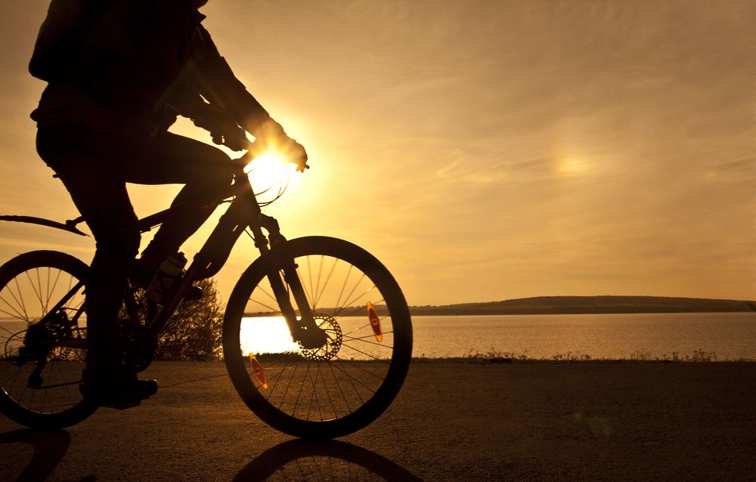
However, the purpose of the talk could be personal. It could be about a memorable day spend cycling – what you did and why it was so enjoyable.

Slide 8
Yet again the purpose could be to give an opinion about the topic. It could be giving your opinion on the idea that everyone should take up the hobby of cycling. This would involve giving reasons for that opinion – the physical health benefits, the mental health benefits, the positive impact on the environment….)

Slide 9
Find out what the purpose of your talk is.

Slide 10
Next find out what the guidelines are in terms of how long the talk is to last. Talks in S1 and S2 generally last around two minutes; in S3 and beyond they tend to last for three minutes.

Slide 11
Anxiety about talks. Remember -
You will have time to prepare the talk.
You can have notes in front of you.
Parents/carers and friends will be able to practice the talk with you before you deliver it.

Slide 12
You have chosen the topic
You know the purpose of the talk
You know the time limit
Now you have to gather the ideas and then edit them.
There are many sources of information and ideas for your talk:
Parents/carers /grandparents/friends
And…………….YOU

Slide 13
Note – taking.

Slide 14
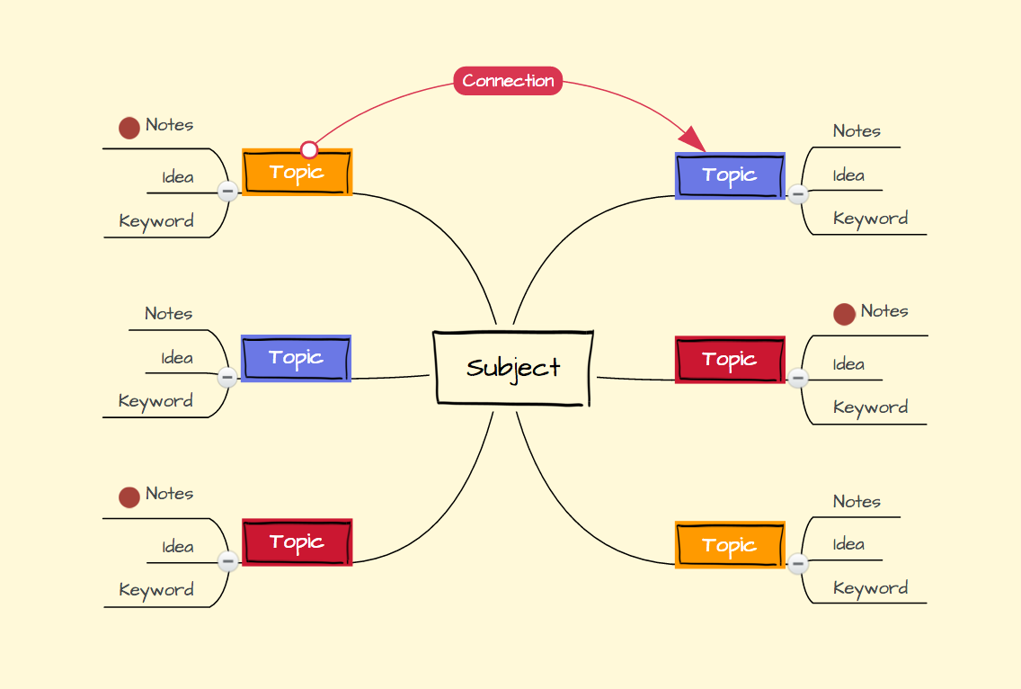
You can gather your ideas together in
Mind Maps

Slide 15
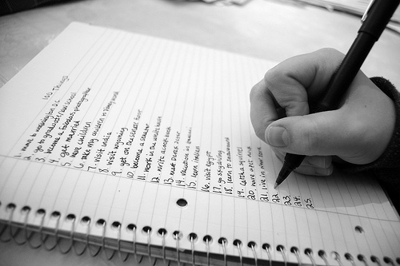
You can gather your ideas together in
Lists

Slide 16
You can gather your ideas together in
Keywords

Slide 17
Example - benefits of cycling
Helps physical health – protects you from strokes ,heart attacks, obesity…..only need two or four hours a week to see an improvement in your health
It is fun
Easy way to exercise of you go to work or school on your bike – does not take high levels of skills like other sports
Increases your stamina
Gets you out of doors which helps your mental health – reduces stress, and depression
Good for the environment – reduces noise pollution. If you were to cycle to work or school 10klm each way over a year you would save 1.3 tonnes of C02

Slide 18
Once you have your ideas together think about structure

Slide 19
The basic structure will have
An introduction – what your topic is and why you have chosen it
The main ideas
A conclusion in which you sum up and perhaps invite questions from the audience.
An interesting variation on this is to begin with a fact, or a story, or personal anecdote, or a question which catches the attention of your audience and then have the structure of introduction, main ideas and conclusion

Slide 20
Think about where you will have your notes
In your jotter?
On cards?

Slide 21
Props
props can help in making the talk interesting, though they are not necessary and you could give a perfectly good talk without them.
props can help with nerves, because the audience will often look at the prop instead of you.
be careful – too many props can be distracting.
Examples of props – if you were doing a talk on cycling you could bring in a photograph of the bike, even a part of the bike – the saddle, for example.

Slide 22
The practice talk

Slide 23
Begin your practice by inspiring yourself. Do this by watching a great talk. These can be found on the internet through sites like You Tube and Ted.
The one below is about the benefits of cycling
https://www.youtube.com/watch?v=WdcAUqGNKAM&t=360s
Ted .

Slide 24
Now start practicing
In the first one aim for two main targets
speak clearly and slowly – you don’t have to shout or act .
make as much eye contact as possible – with parent/carer, cat, goldfish, friend, yourself ( in the mirror )

Slide 25
In the second one add a timer so you know how long you spoke for.
A tip! – no matter how confident you are once you are in the classroom you will speak at a faster pace. In other words when you practice at home the talk may last two minutes but in class it may last a minute and a half. So, aim to have the practice talk last more than the suggested time.

Slide 26
Final preparations
Check that you have your notes
Are you going to use a prop? If so remember to bring it in.
Are you going to use PowerPoint
slides? If so make sure you tell your teacher in advance so it can be organised in time.

Slide 27
Good luck

