Slide 1
Branding
N5 Business Management

Slide 2
What is Branding?
We hear the term branding all the time – but what does it mean?
The process of creating a unique name and image for a product in the consumers’ mind
Branding aims to establish a significant presence in the market that will attract and retail loyal customers.
Branding can be a logo, name or symbol that is given to a group or a type of product.

Slide 3
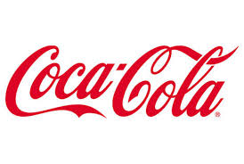

Slide 4
Why Brand Products?
Businesses create a brand for a number of reasons:
It becomes recognisable and can act as a marketing/promotional tool. This helps to distinguish businesses from their competitors.
To encourage customers to become repeat customers – they become “brand loyal”
Higher prices can be charged for branded products because people can associate them with high quality – this can increase profit.
New products can be introduced to the market easily as the brand is already known – Apple releasing iPhones.

Slide 5
Disadvantages of branding?
There are some key issues with having a brand:
If a product within the brand becomes poor or gets a bad reputation then it can damage the reputation of the whole brand name.
Competitors can begin to copy the product giving customers the opinion that it is not a genuine product.
Establishing a brand can be lengthy and expensive – may have an impact on profitability.

